Slide 1
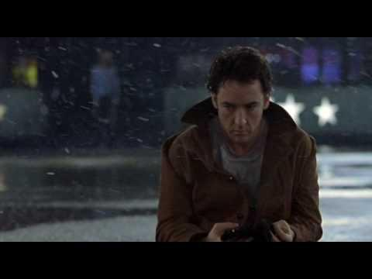

Evaluating Serendipity
Anaconda Disappointed

Slide 2

S E R E N D I P I T Y
"Looking in a haystack for a needle and
discovering a farmer's daughter"
Notes:
We consider different characteristics of 'serendipity' ... >how they are described in existing literature.<
Some studies have used only either novelty / unexpectedness or relevance / usefulness to decide whether an outcome was serendipitous, but more recent ones take both into account.
So how do we decide which characteristics apply in which cases, and how to quantify or measure these characteristics to decide if an event experienced by a user is a serendipitous event or not?
We have been considering the nature of serendipity, how to break it down as a concept, and the complex and fuzzy aspects of serendipity which must be taken into account when designing experiments and collecting data about use of systems that are intended to promote serendipity.
Particularly pertinent are:
- A serendipitous event is an inherently personal and subjective experience.
- People with different backgrounds, intentions and needs (etc) will interpret similar events differently in terms serendipity.
- Similarly the context of an activity that leads to an event will affect to what extent the event is considered serendipitous.
- (Thus) serendipity is not a property of an event, but an opinion about an event by an individual.
- Online activities that lead to serendipitous events are often not driven by an explicit goal. (People browse the Web to pass time, because they are bored, avoiding doing something else, etc).
-

Slide 3
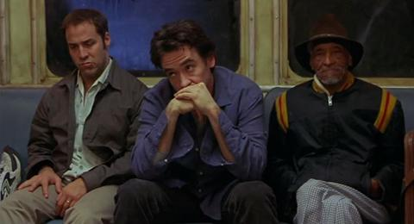
The current state of the art
... serendipity in digital systems ...
Notes:
Serendipity is much discussed in the social sciences and philosophy of science, as well as in computing.
Serendipity is a factor sometimes considered when testing the effectiveness of recommender systems and exploratory search or knowledge acquisition systems. Such systems are intended to provide the user with information that is relevant to them, but may also be unexpected, surprising, or something the user didn't know they were looking for, thus increasing the usefulness or benefit of the system being used.
An example is aemoo, the exploratory search system introduced to us by Valentina to initiate this mini-project. Aemoo aggregates linked data from various sources about the searched item to suggest related results to the user (and explains the connections). To test the effectiveness of aemoo compared to traditional methods of searching, participants were assigned a task (such as "write a summary paragraph about Alan Turing") and asked to carry it out using aemoo. During the process, participants used a web form to record all information they found, and on a scale of 1 to 5, how relevant to the task at hand they found each piece of information, and how unexpected the information was to them. To contextualise these results, background information about the knowledge of the participants specific to the tasks were gathered.
Other studies have tried to evaluate serendipitous outcomes in task-driven experiments. Objectives are typically to set an experiment in which a specific task is assigned, and different metrics are used to evaluate subject's serendipity: these metrics have been both ad-hoc depending on the experiment's scope or domain as well as taken from serendipity studies in the physical world and adapted to the digital environments.
Usually set up experiments followed this schema: a number of users were presented a given task, their interaction through to that goal was observed, and finally they were interviewed via questionnaires about serendipitous activity signals.

Slide 4
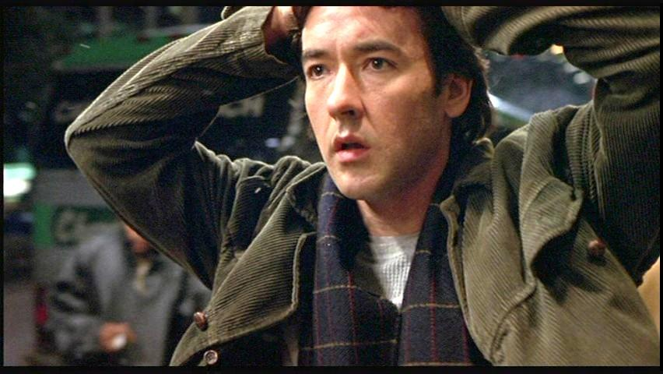
The current state of the art
… some metrics used for evaluation ...
Notes:
There is lots of literature about studying serendipity in the social sciences, but it has been difficult to try and adapt the used techniques into computer sciences. Quantitative aspects of serendipity in research have been considered in at least one thesis; this used 'serendipity stories' - accounts of real world activities from a specific domain - and turned entities in the stories into a quantitative network.

Slide 5

Things to think about
... subjectiveness, restricted domains, experiment constraints ...
Metrics to gather
Actions…
Scrolling, Clicking
Duration and Time
Coverage
User feelings…
Unexpectedness, relevance
Notes:
Things to think about
EXTRA CONSIDERATIONS
users, domains, experiment problems etc
mainly believed people actually change their behaviour when being observed.

Slide 6
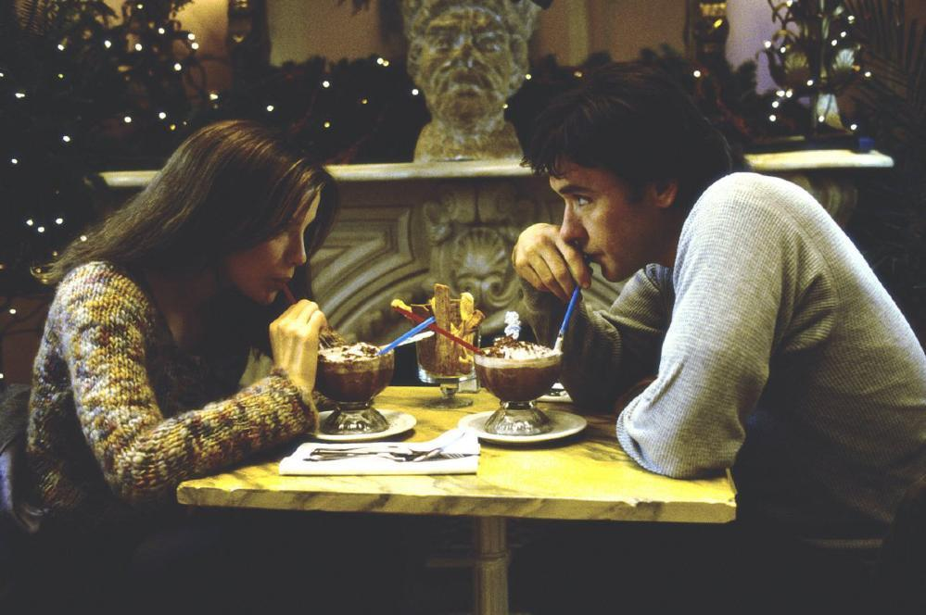
How does CUSACK help?
... building a dataset, releasing a tool ...
Notes:
USING THE DATASET
-> scenarios (open set for general comparison; how to use with constrained experiments; how to gather own data for comparison etc)

Slide 7
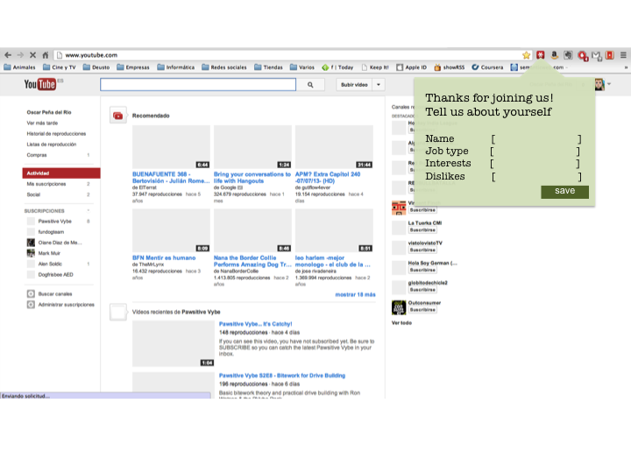
CUSACK: Comparing User Serendipitous Actions while Cruising Knowledge
Notes:
On the next several slides we present some mock-up screens of the browser plugin.
When user initially installs the plugin, we ask them some questions to determine some facts about them.
We collect name (Andrew), Job type (PhD), Interests (Semantics, Ontologies and Linked Data), Dislikes ().
==============================================================================
BUILDING A DATASET
-> user activity spying tool
-> data to collect
- Pre-background questionnaire
- Start trigger
- Mood - questions, are you bored? etc. Scale of interest,
- History URLs
- Time spent on page
- End trigger - active passive
- Post questionnaire

Slide 8
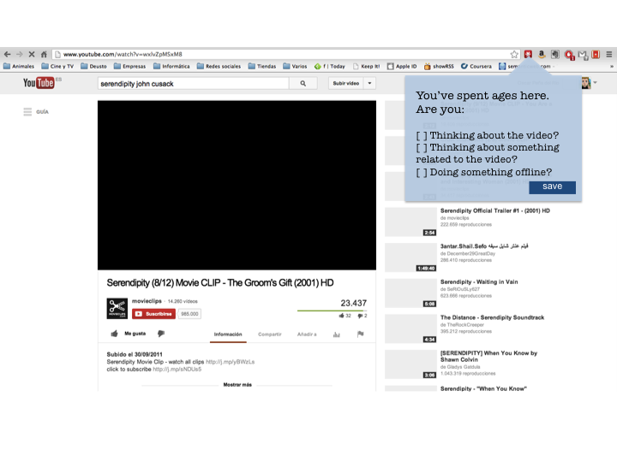
CUSACK: Comparing User Serendipitous Actions while Cruising Knowledge
Notes:
A user watching a YouTube video, watches the length of the video and then does not carryout any further interaction with the webpage.
So to determine if they are thinking about the video, or have gone off for a cup of coffee, we ask them why they are not interacting with the website.
==============================================================================
BUILDING A DATASET
-> user activity spying tool
-> data to collect
- Pre-background questionnaire
- Start trigger
- Mood - questions, are you bored? etc. Scale of interest,
- History URLs
- Time spent on page
- End trigger - active passive
- Post questionnaire

Slide 9
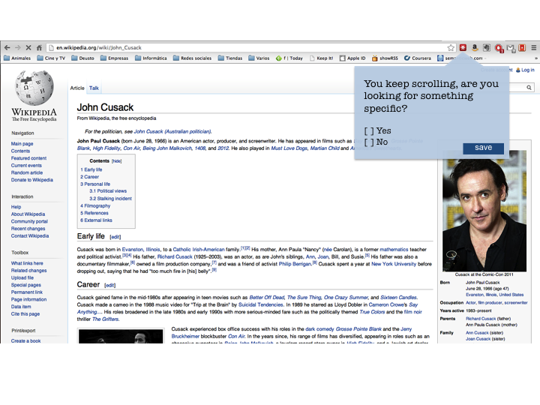
CUSACK: Comparing User Serendipitous Actions while Cruising Knowledge
Notes:
So a user on a webpage can either read through the document bit by bit, or they can rapidly scroll down the document, maybe looking for something specific.
If our plugin detects the user scrolling rapidly down the webpage, then we ask why they have scrolled rapidly down the webpage.
This will enable us to determine if they have an interest in some specific aspect of the webpage or if they are just scanning through the document.
==============================================================================
BUILDING A DATASET
-> user activity spying tool
-> data to collect
- Pre-background questionnaire
- Start trigger
- Mood - questions, are you bored? etc. Scale of interest,
- History URLs
- Time spent on page
- End trigger - active passive
- Post questionnaire

Slide 10
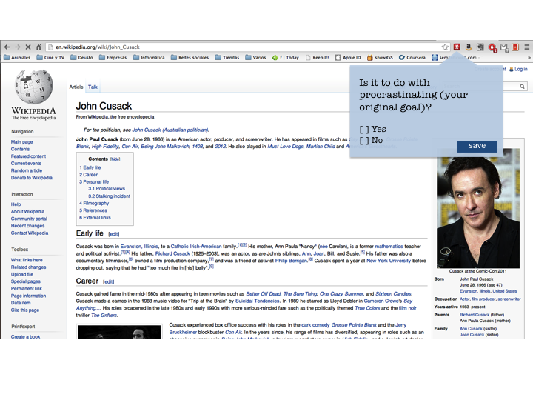
CUSACK: Comparing User Serendipitous Actions while Cruising Knowledge
Notes:
We also prompt the user to tell us if they are just procrastinating or if they have now found something of interest and relating to their original goal, as defined by in the initial questions after plugin install.
==============================================================================
BUILDING A DATASET
-> user activity spying tool
-> data to collect
- Pre-background questionnaire
- Start trigger
- Mood - questions, are you bored? etc. Scale of interest,
- History URLs
- Time spent on page
- End trigger - active passive
- Post questionnaire

Slide 11
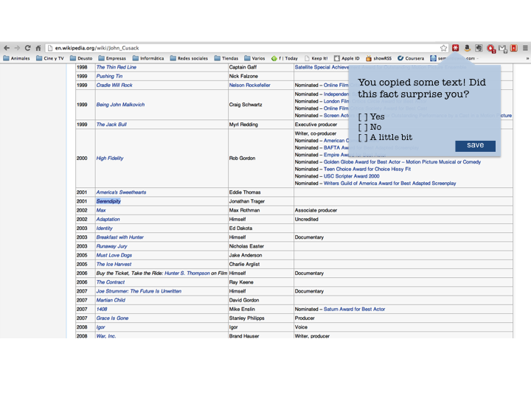
CUSACK: Comparing User Serendipitous Actions while Cruising Knowledge
Notes:
Various user interactions with the webpage can tell us if the user has an interest in the webpage.
For example if the user copies some text, then we know that they have an interest in that information, as they have gone out of there way to copy it.
So we ask them why they copied it.
==============================================================================
BUILDING A DATASET
-> user activity spying tool
-> data to collect
- Pre-background questionnaire
- Start trigger
- Mood - questions, are you bored? etc. Scale of interest,
- History URLs
- Time spent on page
- End trigger - active passive
- Post questionnaire

Slide 12

Semantic Web technologies?
... deeper connections, content analysis, understanding behaviour ...
Notes:
Semantic Web advantages / point

Slide 13
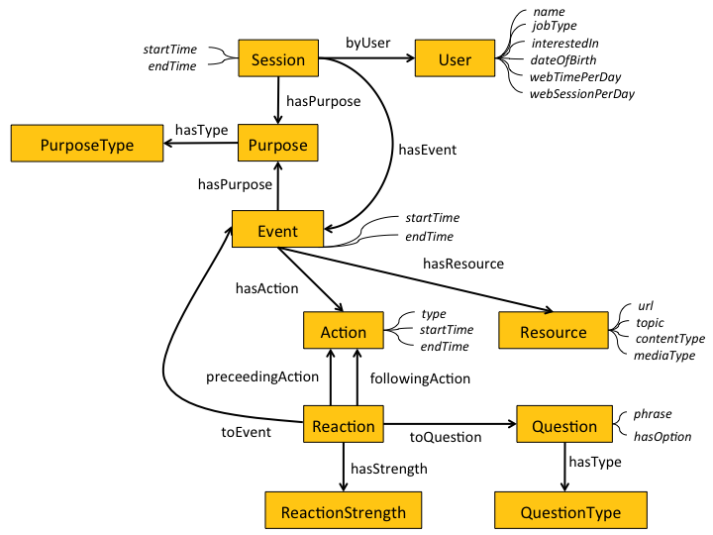

Slide 14
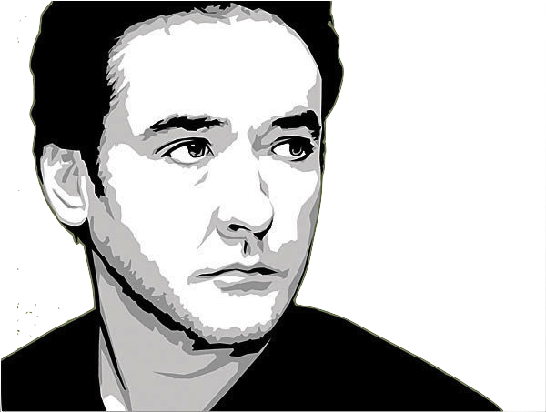


User
Browser Plugin
Server
The Rest Of The World!
Init.
Install plugin
Background questions
Store responses
Automatic annotation tools
Analyze content of pages visited, topics, types, sequence, time spent, etc.
Start browsing session
Process browser data
Classify activity
LOD:
DBpedia, Freebase,
LMDB
Looping
Store quantitative and qualitative information
Interact with CUSACK
Browsing questions
If more data is needed
Profiling/classifying learning behaviour
Workout what this all means!
Sporadically
End session
Leaving questionnaire
Store results
Notes:
And here is the architecture that supports this, and the data flow between the user browsing the web, the UI is the form of a browser plugin, the Server, reasoning, analysis and data storage behind the scenes, and how's this connected to external tools.

Slide 15
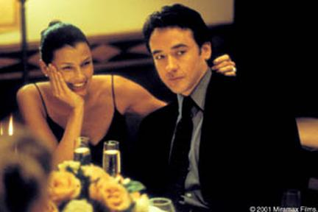
What happens next?
... future development, research, use ...
Build a dataset
Look for patterns
Implement plugin
Evaluate Framework
Notes:
Future development / research / use etc.
What needs thinking about.
Look for patterns in the massive dataset gathered to enable predictions.
Evaluate the framework

Slide 16
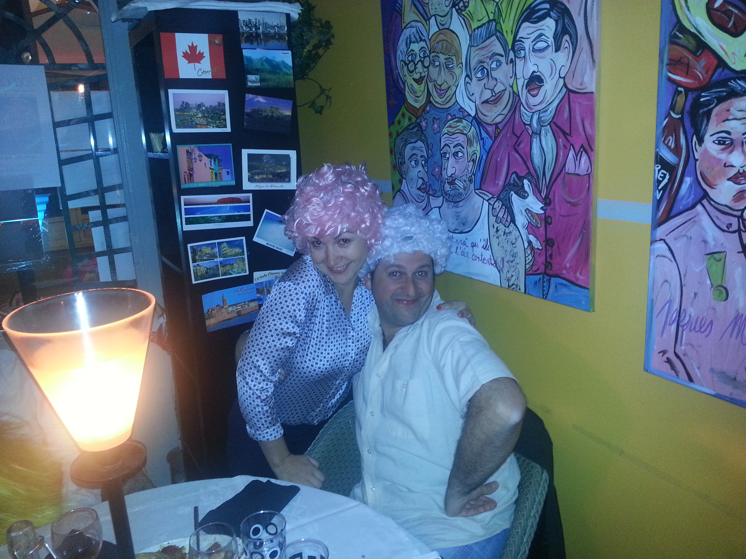
Unexpected… right?
Notes:
BUILDING A DATASET
-> user activity spying tool
-> data to collect
- Pre-background questionnaire
- Start trigger
- Mood - questions, are you bored? etc. Scale of interest,
- History URLs
- Time spent on page
- End trigger - active passive
- Post questionnaire

Slide 17

Credits References
Starring, written and directed by
Andrew Ennis
Amy Guy
Josef Hardi
Oscar Peña del Rio
Produced by
Valentina Presutti
Featuring
John Cusack
Kate Beckinsale
Assisted by
Akiyama, Takayuki, Kiyohiro Obara, and Masaaki Tanizaki. "Proposal and evaluation of serendipitous recommendation method using general unexpectedness." Workshop on the Practical Use of Recommender Systems, Algorithms and Technologies (PRSAT 2010). 2010.
McBirnie, A. "A Descriptive Profile of Process in Serendipity: A Narrative and Network Study of Information Behaviour in Context", PhD thesis, Aberystwyth University, Aberystwyth (2012).
McCay-Peet, Lori, and Elaine G. Toms. "Measuring the dimensions of serendipity in digital environments." Information Research 16.3 (2011): 16-3.
Ge, Mouzhi, Carla Delgado-Battenfeld, and Dietmar Jannach. "Beyond accuracy: evaluating recommender systems by coverage and serendipity."Proceedings of the fourth ACM conference on Recommender systems. ACM, 2010.
Bogers, Toine, Rune Rosenborg Rasmussen, and Louis Sebastian Bo Jensen. "Measuring Serendipity in the Lab: The Effects of Priming and Monitoring." (2013): 703-706.
Alani, Harith, et al. "Mining for Social Serendipity."
McCay-Peet, Lori, and Elaine G. Toms. "Proposed Facets of the Serendipitous Digital Environment."
André, Paul, Jaime Teevan, and Susan T. Dumais. "Discovery is never by chance: designing for (un) serendipity." Proceedings of the seventh ACM conference on Creativity and cognition. ACM, 2009.
Burke, Robin. "Hybrid recommender systems: Survey and experiments." User modeling and user-adapted interaction 12.4 (2002): 331-370.
Campos, José, and Antonio Dias de Figueiredo. "Searching the unsearchable: Inducing serendipitous insights." Proceedings of the Workshop Program at the Fourth International Conference on Case-Based Reasoning, ICCBR. 2001.
De Bruijn, Oscar, and Robert Spence. "A new framework for theory-based interaction design applied to serendipitous information retrieval." ACM Transactions on Computer-Human Interaction (TOCHI) 15.1 (2008): 5.
Foster, Allen, and Nigel Ford. "Serendipity and information seeking: an empirical study." Journal of Documentation 59.3 (2003): 321-340.
AND THEY LIVED HAPPILY EVER AFTER
Notes:
Make credits scroll if there's enough

